Slide 1
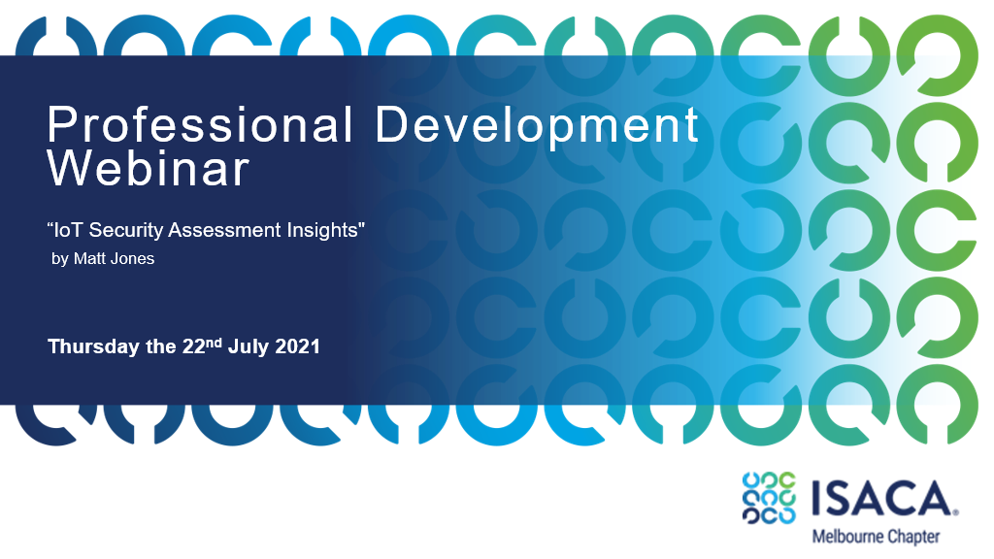

Slide 2
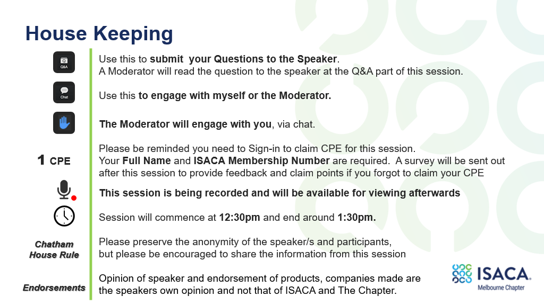

Slide 3
IoT Security Assessment Insights
ISACA Melbourne

Slide 4
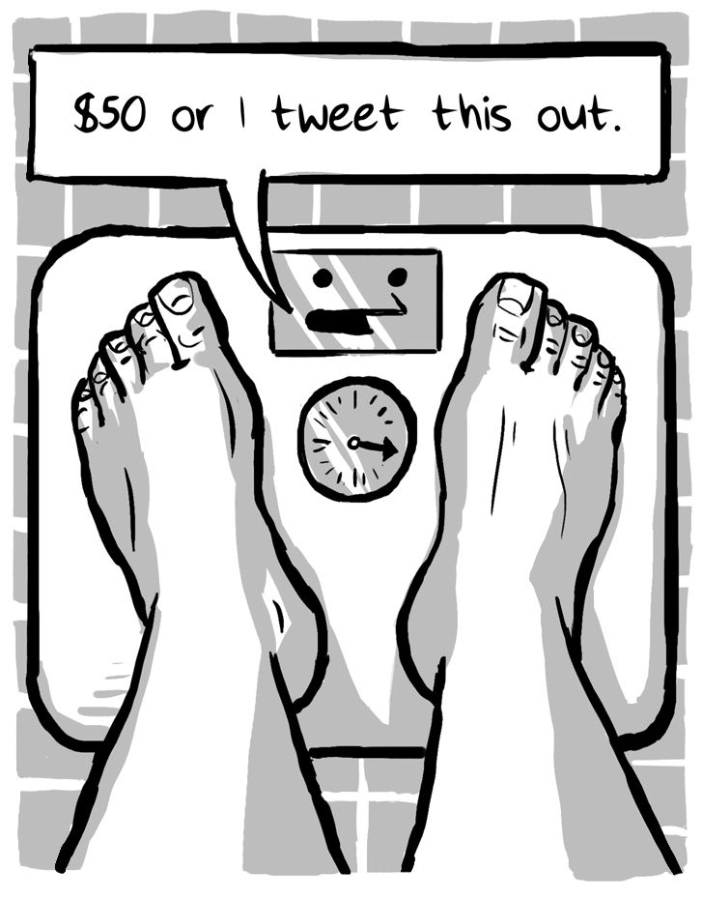
Hello!
Goal of this talk
Share insights from performing IoT security assessments over the years
Summarise the different types of approaches and common patterns seen
Share perspective on end-to-end concepts with examples and considerations
Provide a handful of useful resources and references related to IoT security
Spoiler: This is not intended to be a technical talk!

Slide 5


Hello!
About myself
I’m a cofounder / director of
I work as a principal consultant but also oversee a lot of technical assessments
I’ve been working in infosec for almost 20 years in a variety of technical roles
I help out with the CFP review for BSidesCbr each year

Slide 6
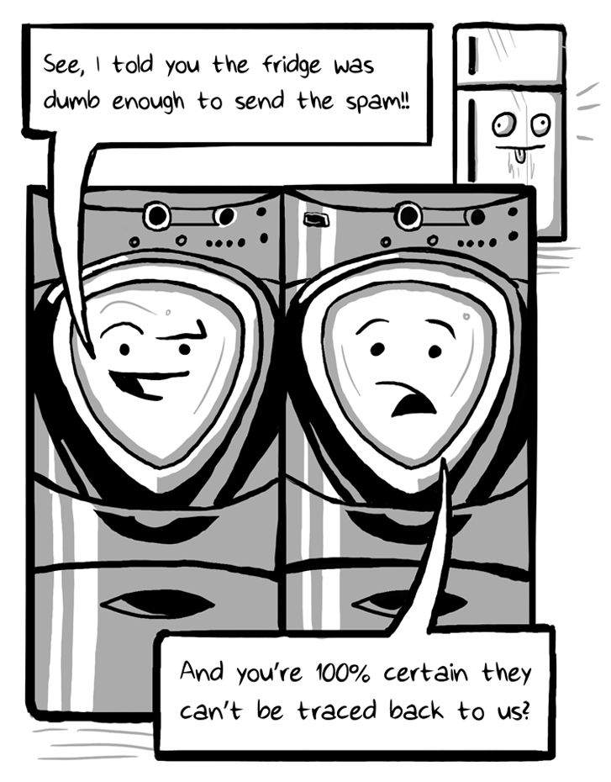
Agenda
Intro and background
Assessment types and approaches
Case Studies
Resources and references
Q&A

Slide 7
Intro and background

Slide 8
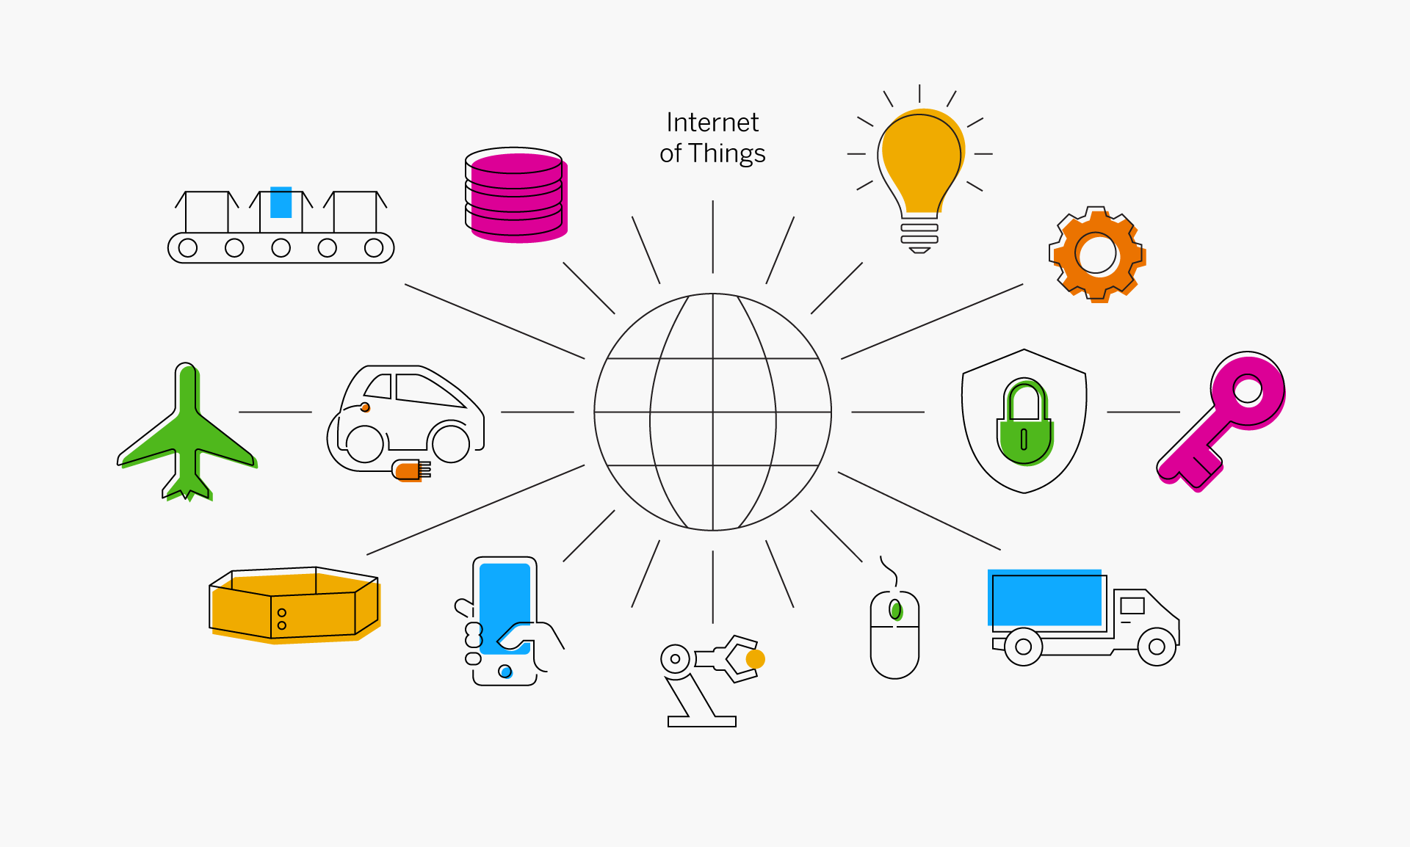

Slide 9

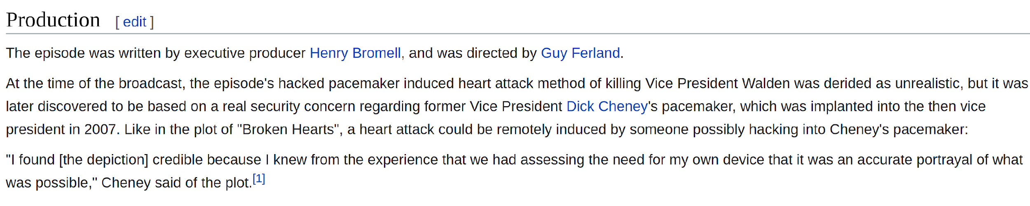


Slide 10
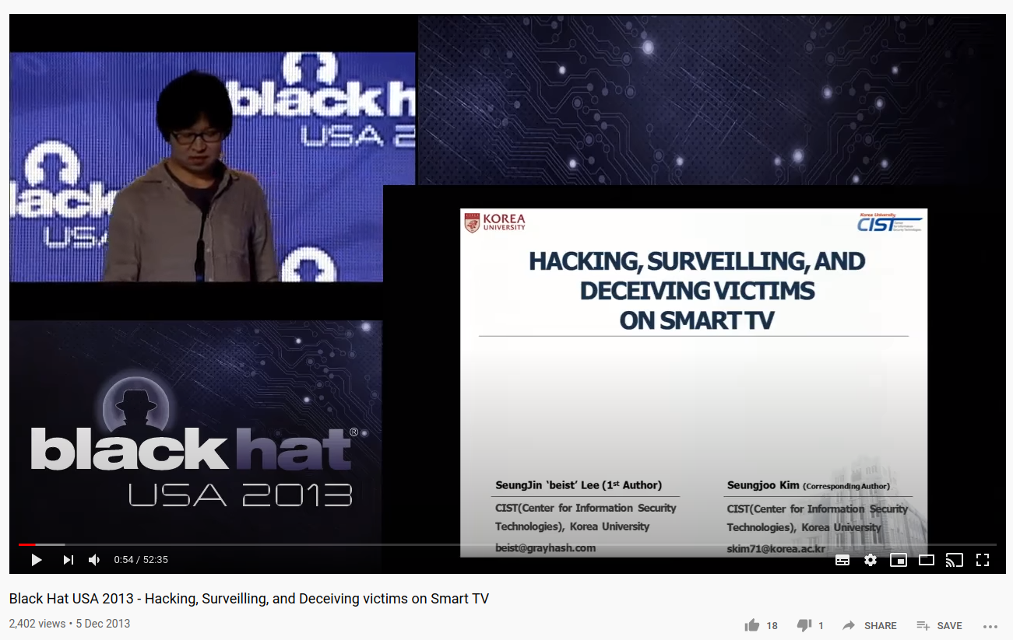
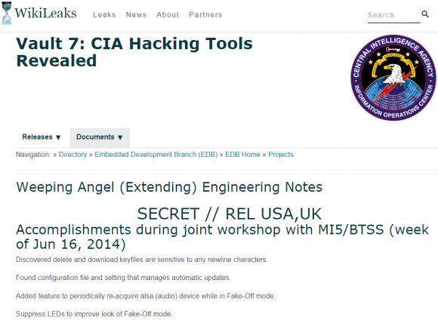

Slide 11


Slide 12
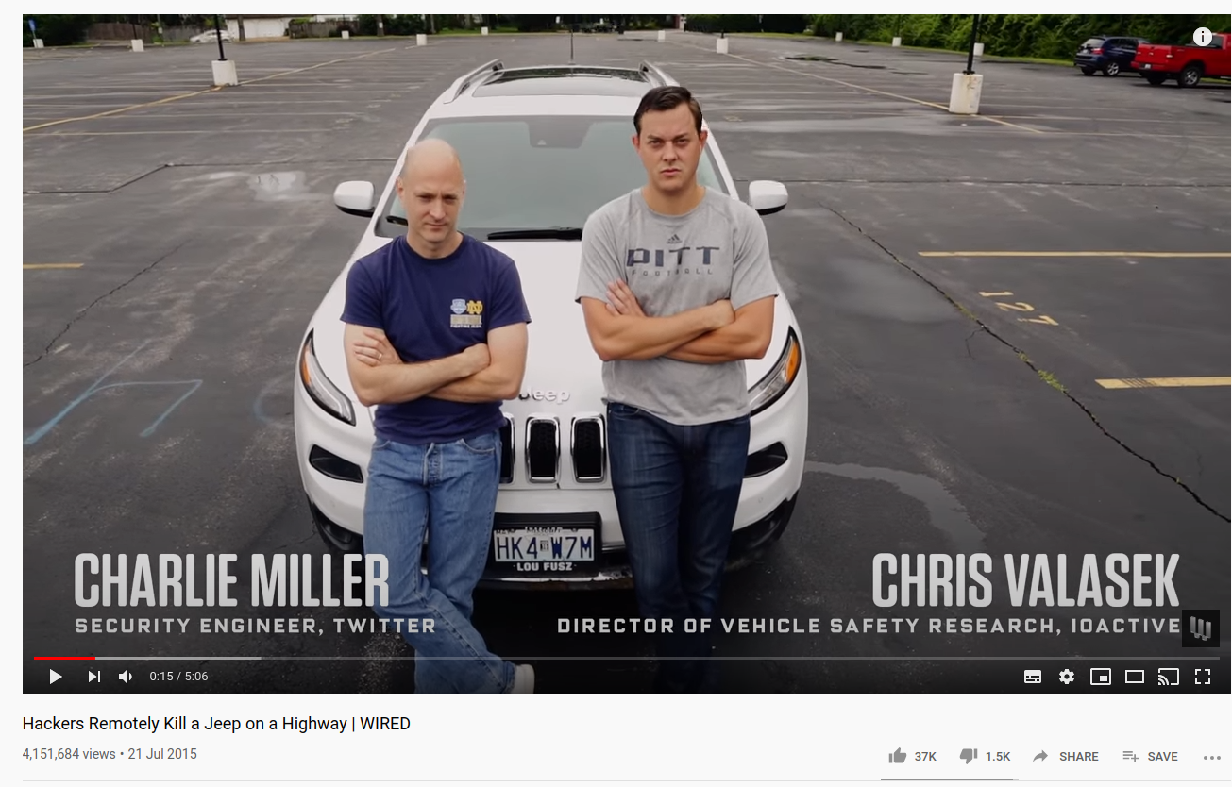
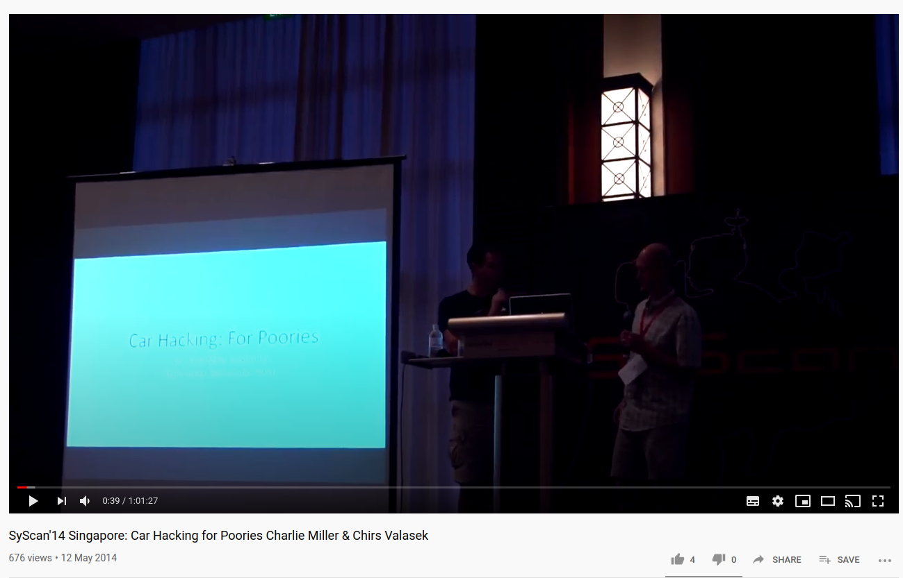

Slide 13
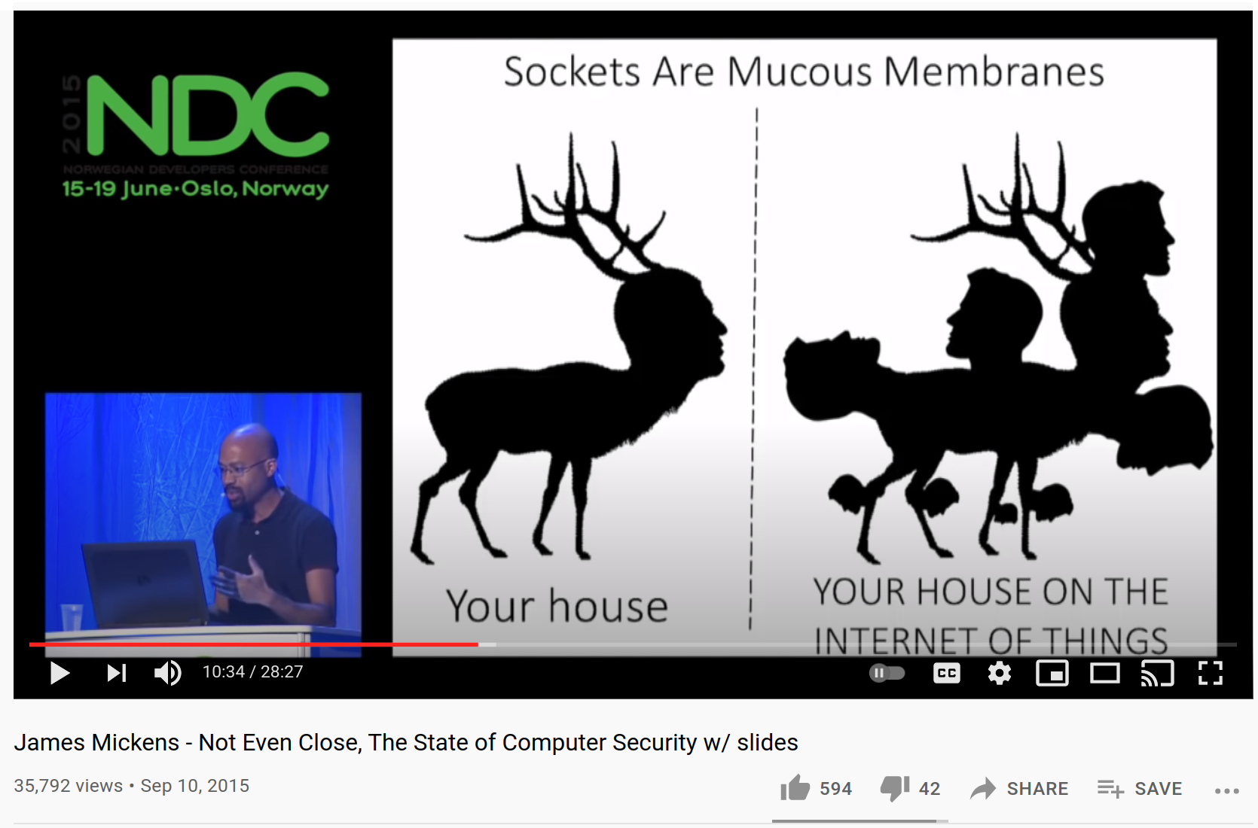
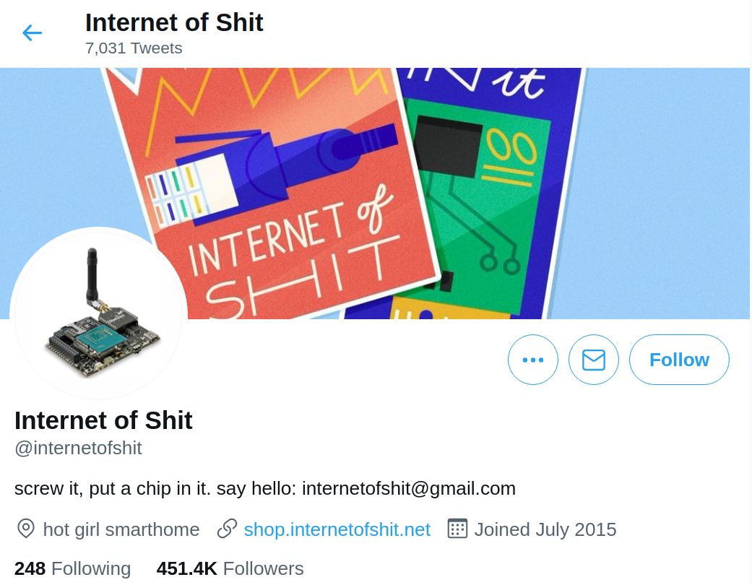

Slide 14
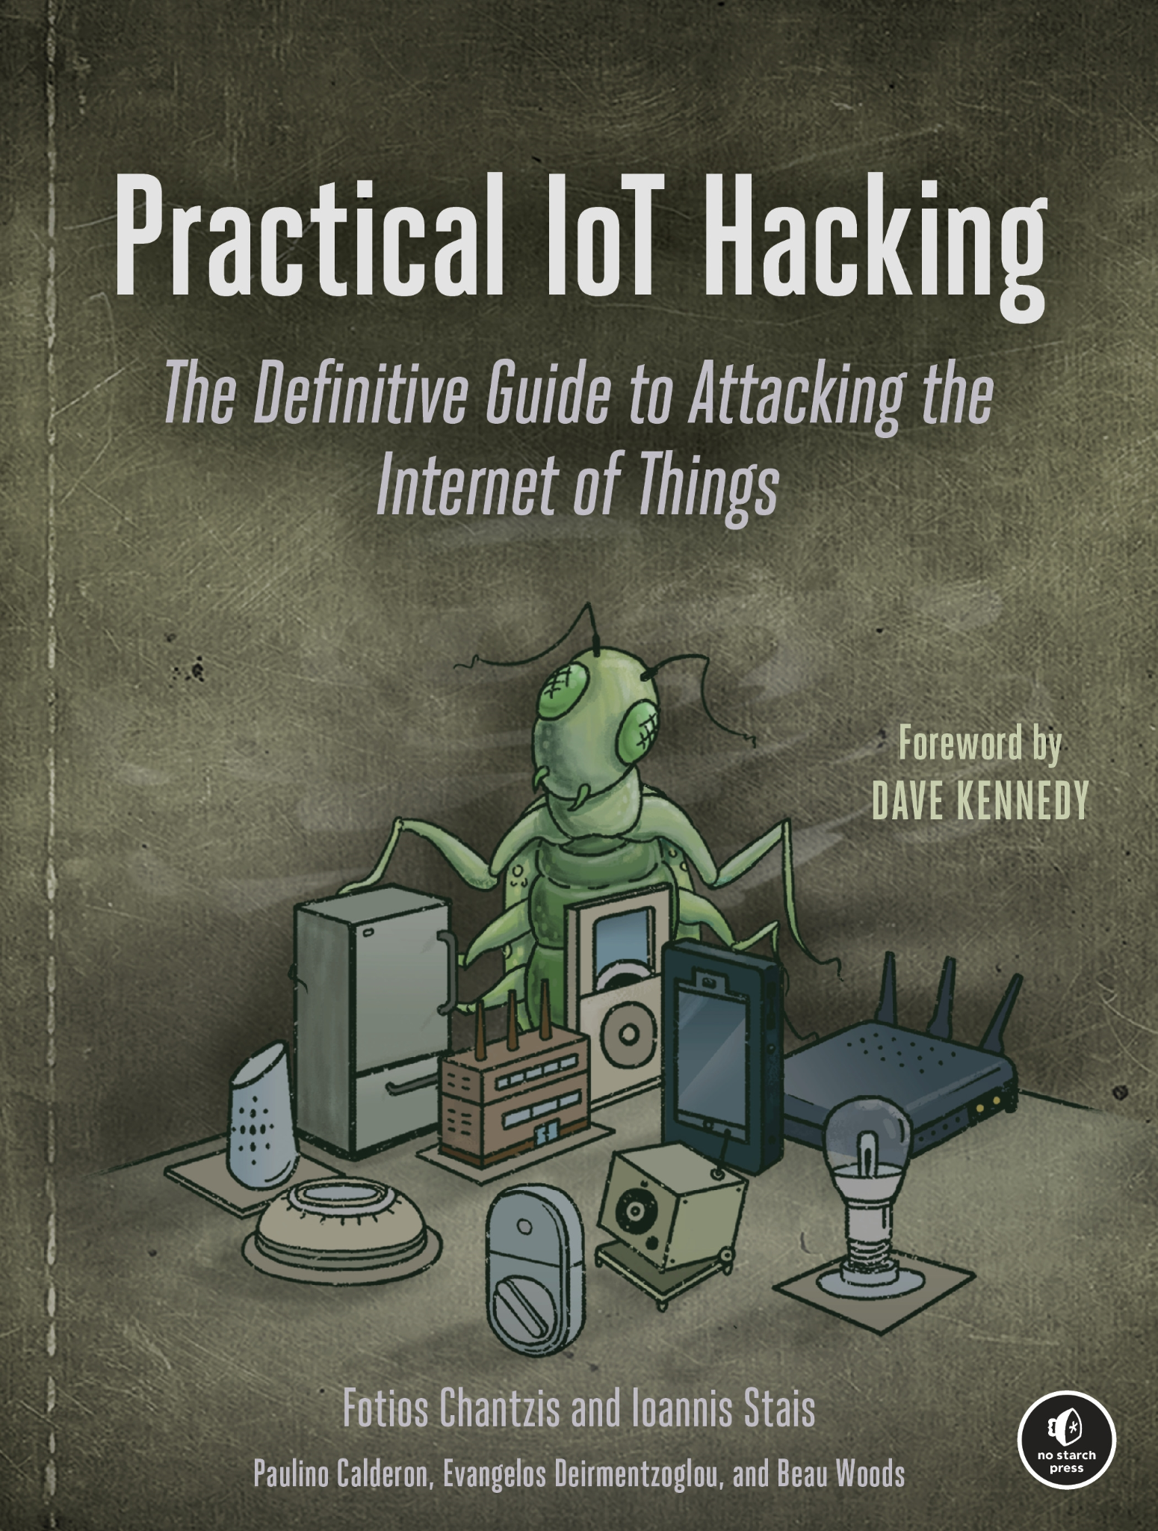






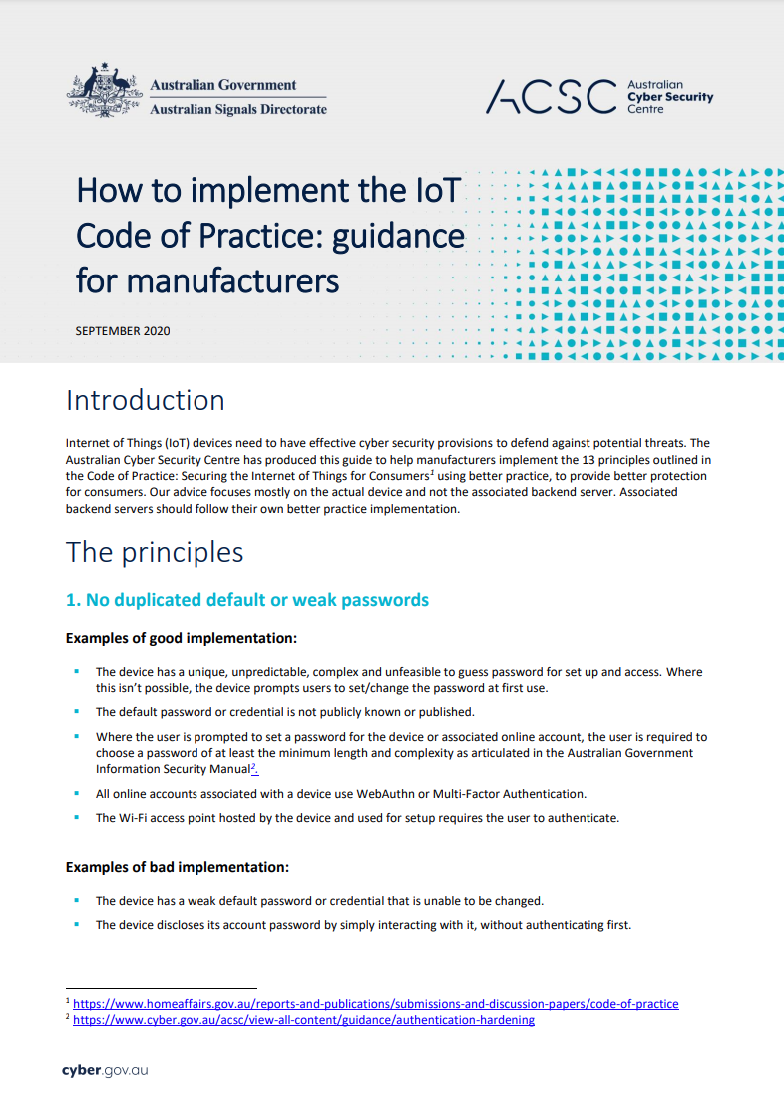
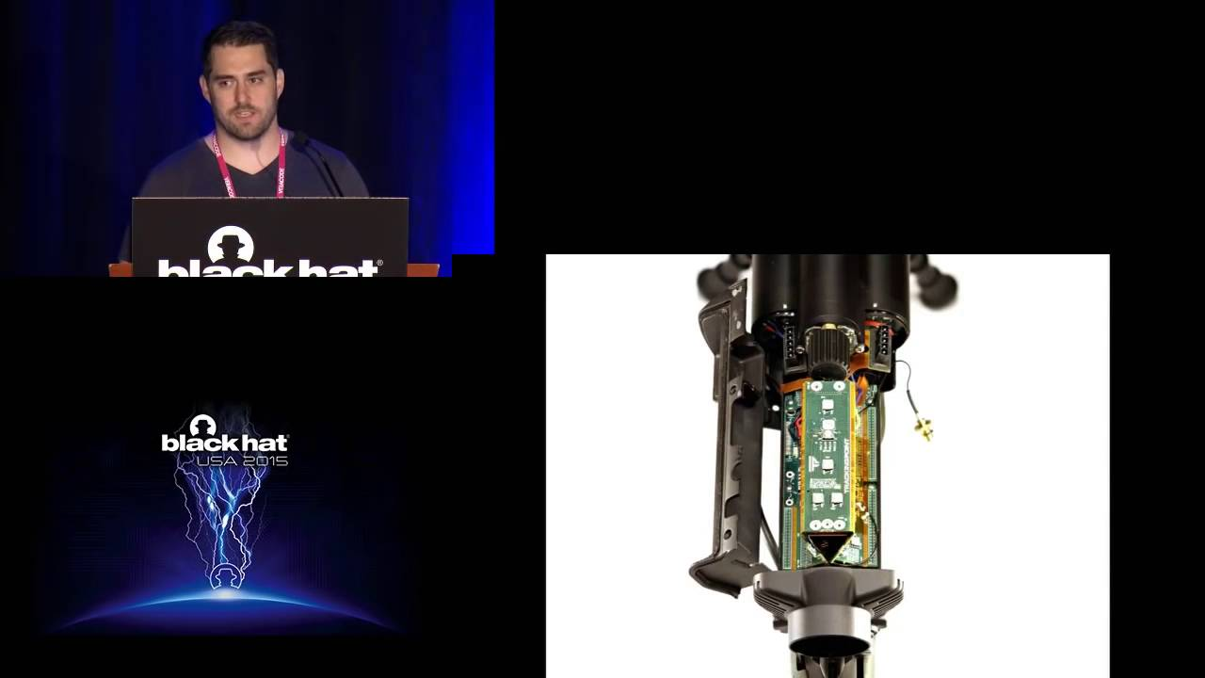
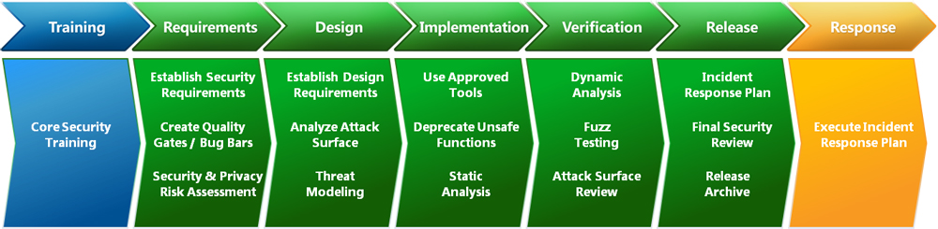
So, where does this talk come from?
IoT testing and research
Guidelines and standards
I want to share my perspective from consulting experience with a lens on IoT.
My role is often connecting the dots when performing threat-driven assessments and ultimately helping organisations build more secure technologies

Slide 15
Assessment types and approaches

Slide 16
Assessment types
Black-box Product Assessment
Generic scope and seeking a black-box methodology, typically compliance driven and may or may not be complimenting internal efforts.
1
Focused Threat-Driven Assessment
Specific goals, focused scope items, clear outcomes, and complimenting internal efforts. Typically white-box or threat driven test cases
2
Holistic White-box Platform Assessment
Specific tactical and strategic goals, wide scope but with priority items during detailed scoping. White-box and collaborative while understanding the whole landscape..
3

Slide 17
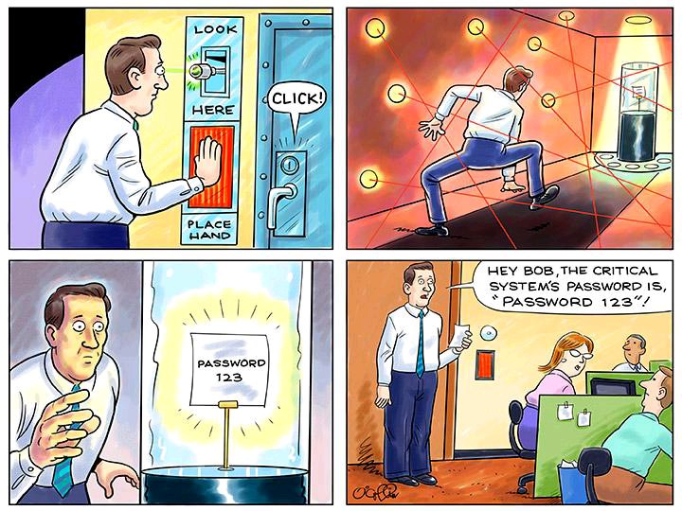
Ensuring pragmatic testing

Slide 18
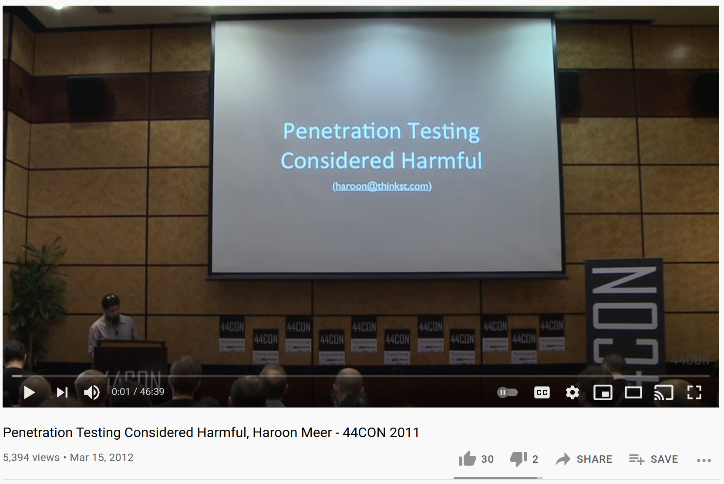
Ensuring pragmatic testing
Using a threat driven approach to testing to balance breadth and depth of testing
Generally we try to follow a white-box methodology to remove guessing if possible
Source code assisted
Collaborative engagement
Resources and scheduling needs to match the skill and effort required
Requires ongoing technical training in the team and keeping up with new research
May require dedicated training courses or guided learning
May require 2+ months lead time
We need to also know our limitations
https://www.youtube.com/watch?v=GvX52HPAfBk

Slide 19
An overview of common activities during a test
Scoping & Planning
Auditing & Testing
Final Analysis & Handover
Review architecture, identify trust boundaries, understand components
Study data sheets, product manuals, etc.to identify trust boundaries
Design attack scenarios for customer signoff
Attend any required training and preparation research
Pull persistent storage from device for RE / emulation
Physical interfaces (I2C, SPI, Radios …)
Logical interfaces (network transport protocols [WiFi, Zigbee] & network services
Follow our appropriate methodologies (embedded, mobile, cloud, web API, etc.)
Develop proof of concept attacks to demonstrate real-world risk
Root cause analysis
Research tactical and strategic recommendations
Present findings and incorporate feedback to ensure its realistic and actionable

Slide 20
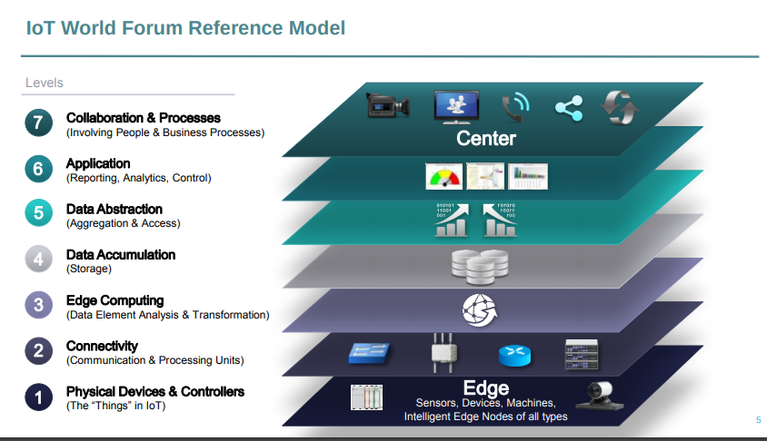
Threat models and understanding context
Starts with learning the trust boundaries and entry-points across the architecture
Considers the architecture, design patterns and technology stacks
Identifying critical security controls that require validation and gray areas requiring investigation
Often this requires open dialogue and discussion on concerns and priorities
Balancing breadth vs. depth and how to translate results

Slide 21


Slide 22
Case Studies

Slide 23

Case Study 1: Holistic White-box Platform Assessment
Commonly Seen:
Mergers and Acquisitions
Comprehensive Security Testing Requirement (e.g. strategic planning)
New product launch
Typical Scope:
Device with peripherals
Web Services Layer
Cloud infrastructure
Mobile applications
Management interfaces
Typical Duration:
Ranges between 6-16 weeks of effort
Case Study:
A smart vehicle

Slide 24

Case Study 1: Holistic White-box Platform Assessment
Industry: Transport and Automotive Purpose: Embedded device integrated with a CAN bus with smart applications Approach: Threat model to primarily white-box assessment Duration: 16 weeks Objective: Review a legacy device and also modern cloud/web services environment Example Attack Surface:
Physical ports (USB, Ethernet, etc.)
Over the air protocols for phone and wireless
A mobile application that allows remote features
Communication channels back to the cloud
Web-services with a focus on access control

Slide 25

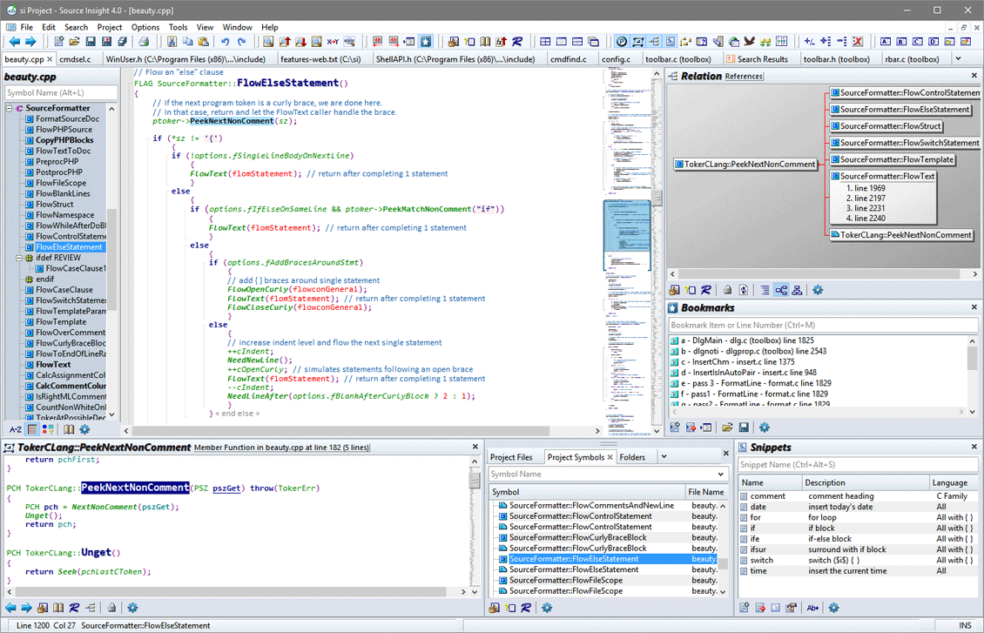
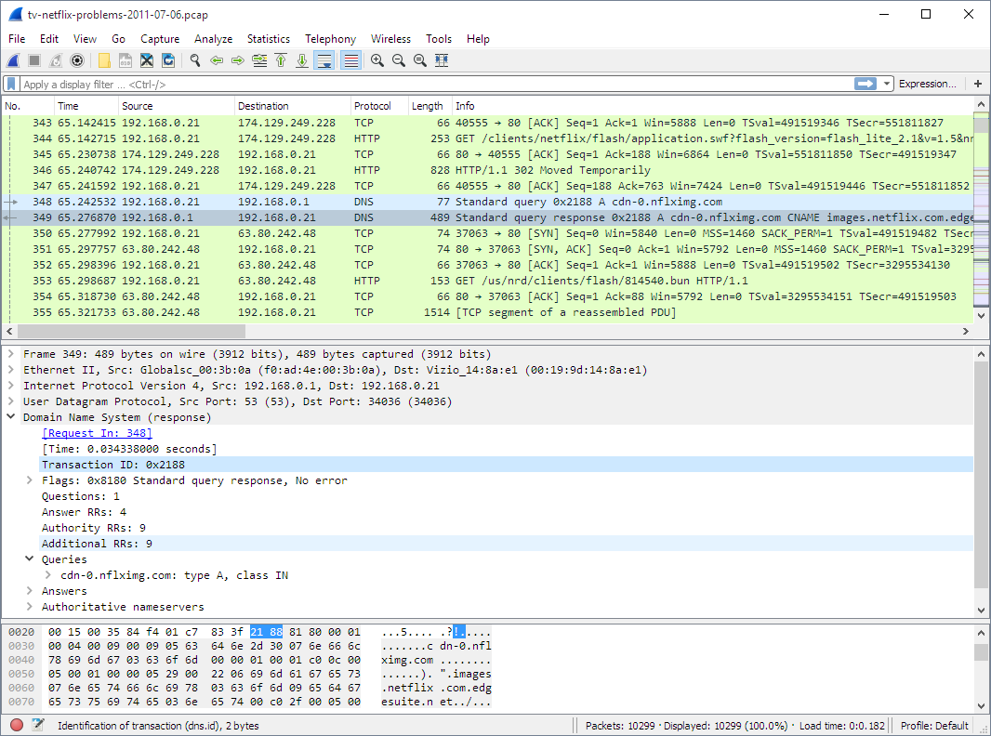




Case Study 1: Holistic White-box Platform Assessment
Our Approach:
Review of a more legacy embedded device:
Host system review using security benchmarks
Embedded device review to identify physical attack surface and assuming ‘untrusted’
Sniffing network traffic and understanding comms and RE’ing proprietary protocols
Static analysis, code review and runtime testing of the software running on the device
White-box code-assisted testing assessment across C/C++, Python, Java and Native React software components
Review of modern cloud, mobile and web services:
Web services testing prioritising access control
Mobile application review with proximity features
Cloud security review of a Kubernetes cluster

Slide 26

Case Study 1: Holistic White-box Platform Assessment
Outcome:
Multiple critical issues affecting the device
The modern components had some findings, but overall mature
Tactical:
Advice on adding exploit mitigations to the legacy binaries
Advice on uplifting systemic dangerous coding constructs
Attack surface reduction
Strategic:
Feeding output from the device assessment to the new generation specs to follow recommended standards
Helping to uplift secure SDLC of new components

Slide 27
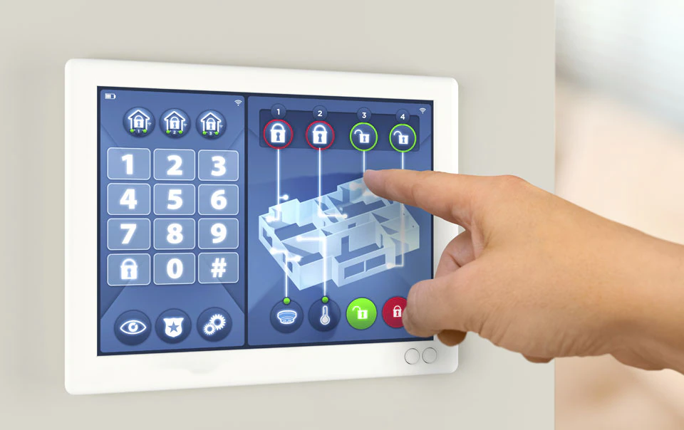
Case Study 2: Focused Threat-Driven Assessment
Commonly Seen:
Deep dive technical features
Product updates and feature launches
Security engineering support during design and prototyping
Security verification testing of a black-box product with a clear threat model
Typical Scope:
Device with peripherals
Web Services / Cloud integration
Typical Duration:
Ranges between 2-8 weeks of effort
Case Study:
A smart alarm

Slide 28
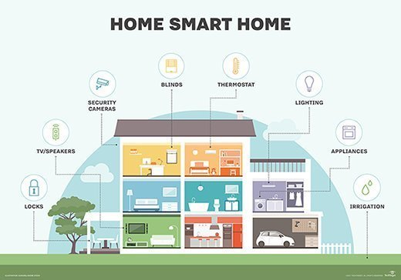
Case Study 2: Focused Threat-Driven Assessment
Industry: Hired by an organisation to review a black-box security system Purpose: A home security system used by VIP embracing smart-home technologies Approach: Black-box Duration: 1 week Objective: “Please see if you can break this.” Example Attack Surface:
TBD

Slide 29
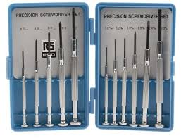
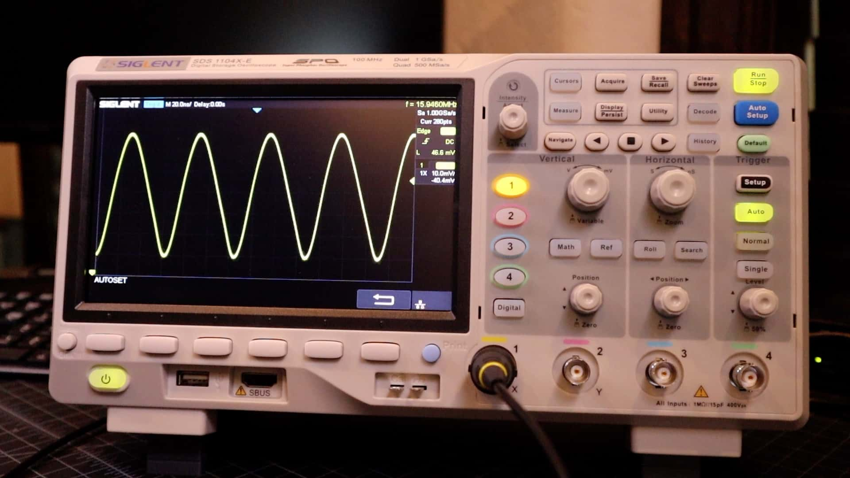
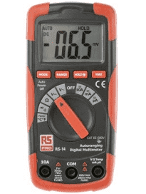
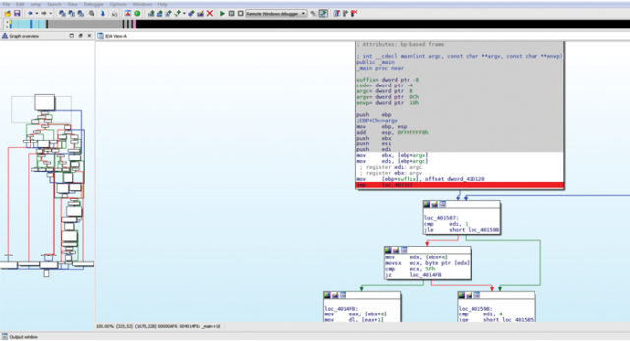
Case Study 2: Focused Threat-Driven Assessment
Our Approach:
Physically dismantling the Alarm, dumping firmware stored on SPI flash
Reverse engineered the logic to identify design and implementation issues
TAP Ethernet/Wifi interfaces and investigated transport security issues and created a test harness
Created a prototype of the Alerting protocol observed through static and dynamic analysis

Slide 30
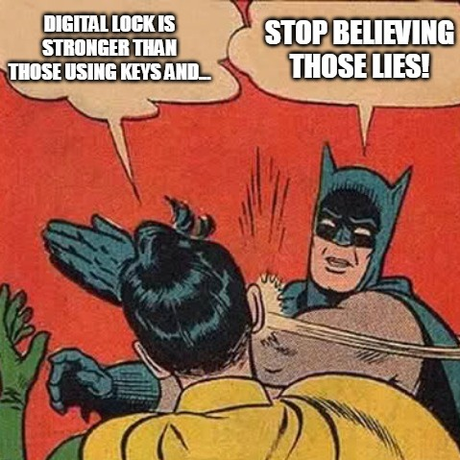
Case Study 2: Focused Threat-Driven Assessment
Outcome:
Successfully bypassed the alarm by spoofing a ‘everything is fine’ packet to the servers and then being able to physically cut the alarm
Tactical: Helped to provide details to the vendor for patching a handful of security findings.
Strategic: Discussion with the vendor on the threat model and how to counter a handful of theoretical attacks.

Slide 31

Case Study 3: Black-box Product Assessment
Commonly Seen:
COTS products requiring security review
New customers who are not ready to commit to white-box audits
Situations when a customer doesn’t own all the IP of a specific solution
Typical Scope:
Device with peripherals
Web Services / Cloud integration
Typical Duration:
Ranges between 2-4 weeks of effort
Case Study:
A IoT security product

Slide 32
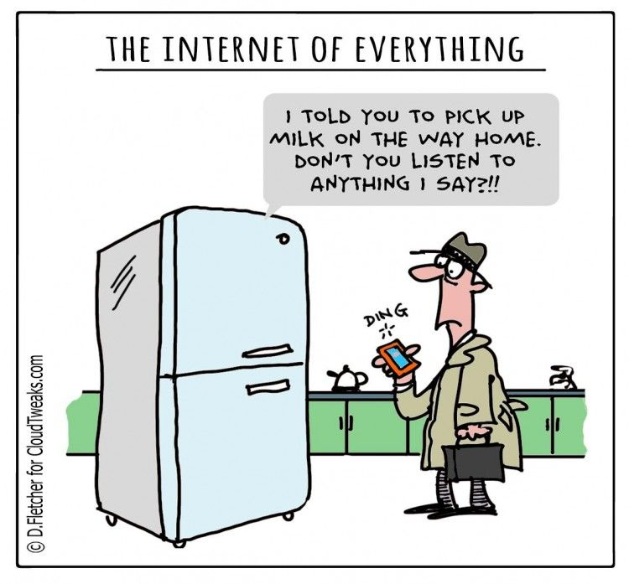
Case Study 3: Black-box Product Assessment
Industry: Hired by a security vendor to perform a black-box penetration test of their product Purpose: A security product focused on IoT Approach: Black-box Duration: 2 weeks Objective: “I just need a report and heard you folks were good, but I don’t think you’ll find anything” Example Attack Surface:
Network packet parsing (nothing could go wrong, right?)

Slide 33
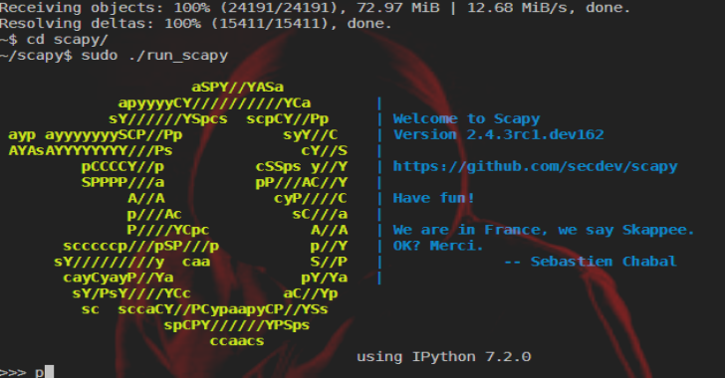

Case Study 3: Black-box Product Assessment
Our Approach:
Initially plonked on a test network with the appliance running
Decided to social engineer their sales team to give us a virtual appliance
Spent time reverse engineering a bunch of binaries
Used Scapy to send malformed Data Link (Ethernet), Network (ARP/IP/ICMP), and Transport (TCP/UDP) packets to assist in testing and vulnerability discovery.
Use Cloud management console to send malformed instructions to the device and watch behavioural changes.

Slide 34

Case Study 3: Black-box Product Assessment
Outcome:
Compromised cloud agent gains access to ALL network traffic from WAN
Tactical: Patching critical vulnerabilities and dangerous coding constructs, attack surface reduction
Strategic: Guiding hardening and userland sandboxing of parsers. Updating controls to factor in untrusted devices.

Slide 35
Resources and references

Slide 36
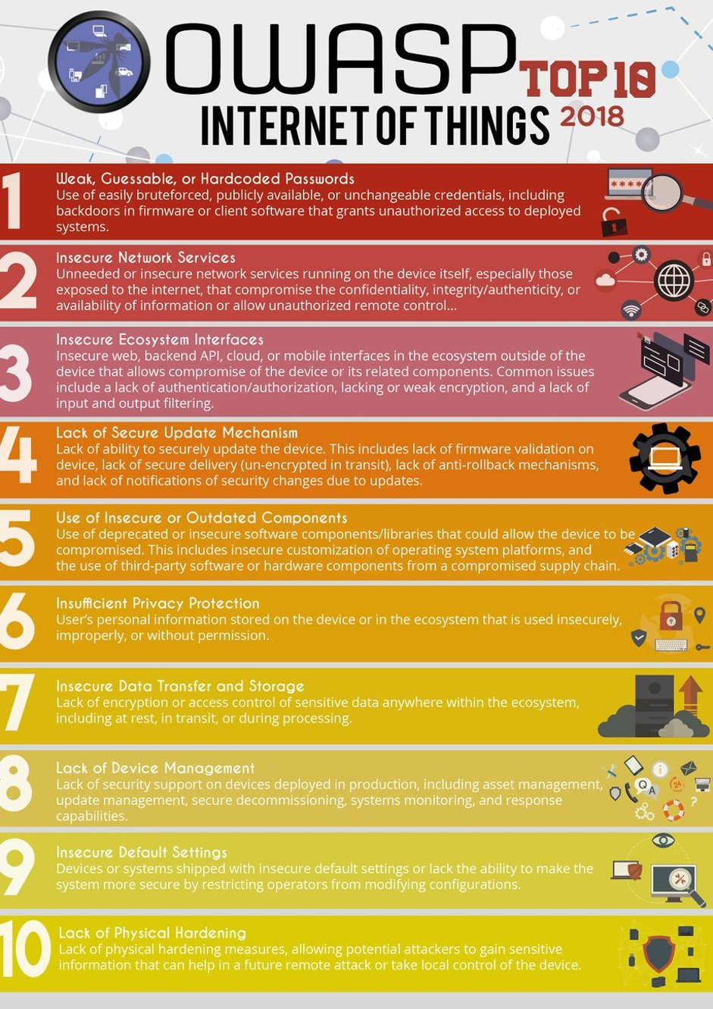
Advice for internal champions / security teams
Basic secure design review and security testing needs to be part of internal review and quality assurance activities
Start with the high-level architecture and how it counters the OWASP IoT Top 10 and then move onto the the OWASP IoT testing methodology
Know the ACSC IoT Guidelines for manufacturers and IoT Codes of Practice for Consumers
Learn when and how to engage third-parties to perform design review and verification security testing
Avoid vulnerability whack-a-mole at all costs - invest in eradicating vulnerability classes and mitigations.
https://owasp.org/www-pdfarchive/OWASP-IoT-Top-10-2018-final.pdf

Slide 37

https://www.cyber.gov.au/acsc/view-all-content/publications/iot-code-practice-guidance-manufacturers
https://www.homeaffairs.gov.au/reports-and-pubs/files/code-of-practice.pdf

Slide 38
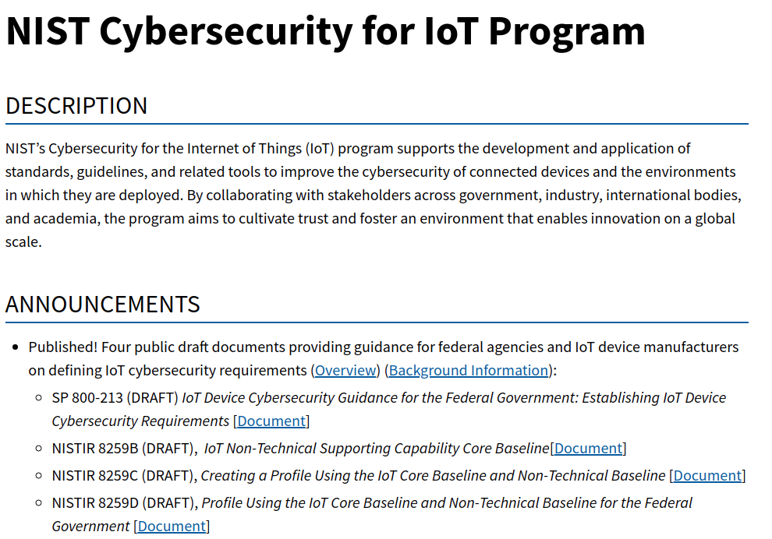
https://www.nist.gov/programs-projects/nist-cybersecurity-iot-program

Slide 39
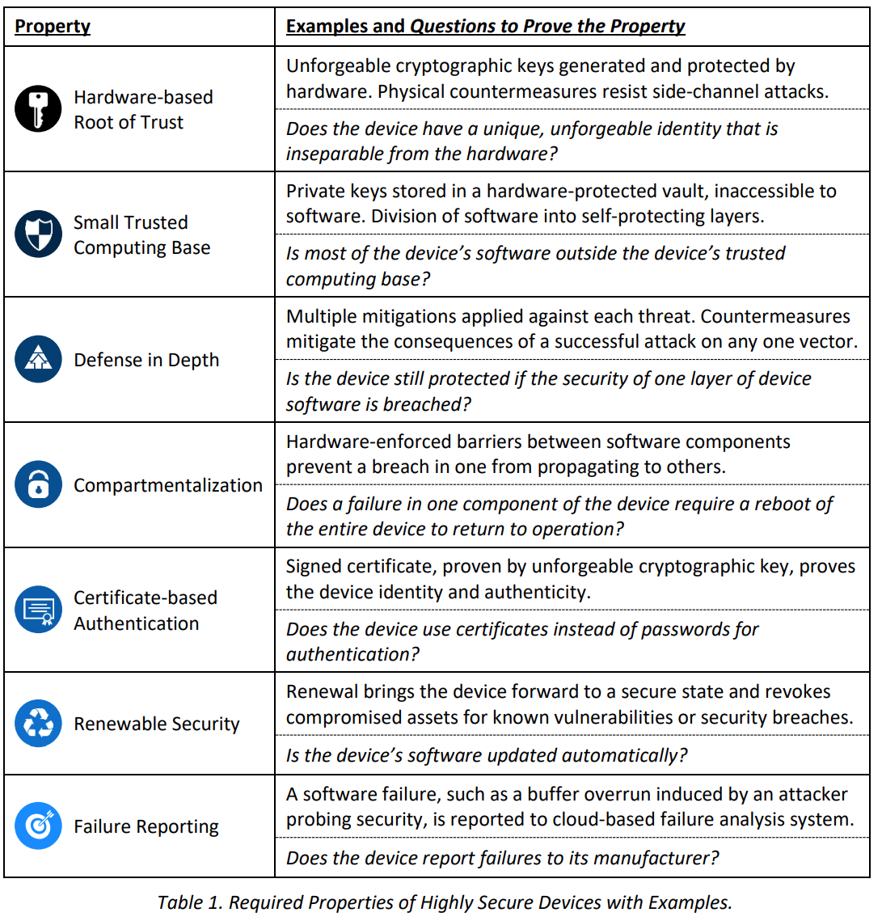
https://www.microsoft.com/en-us/research/wp-content/uploads/2017/03/SevenPropertiesofHighlySecureDevices.pdf

Slide 40
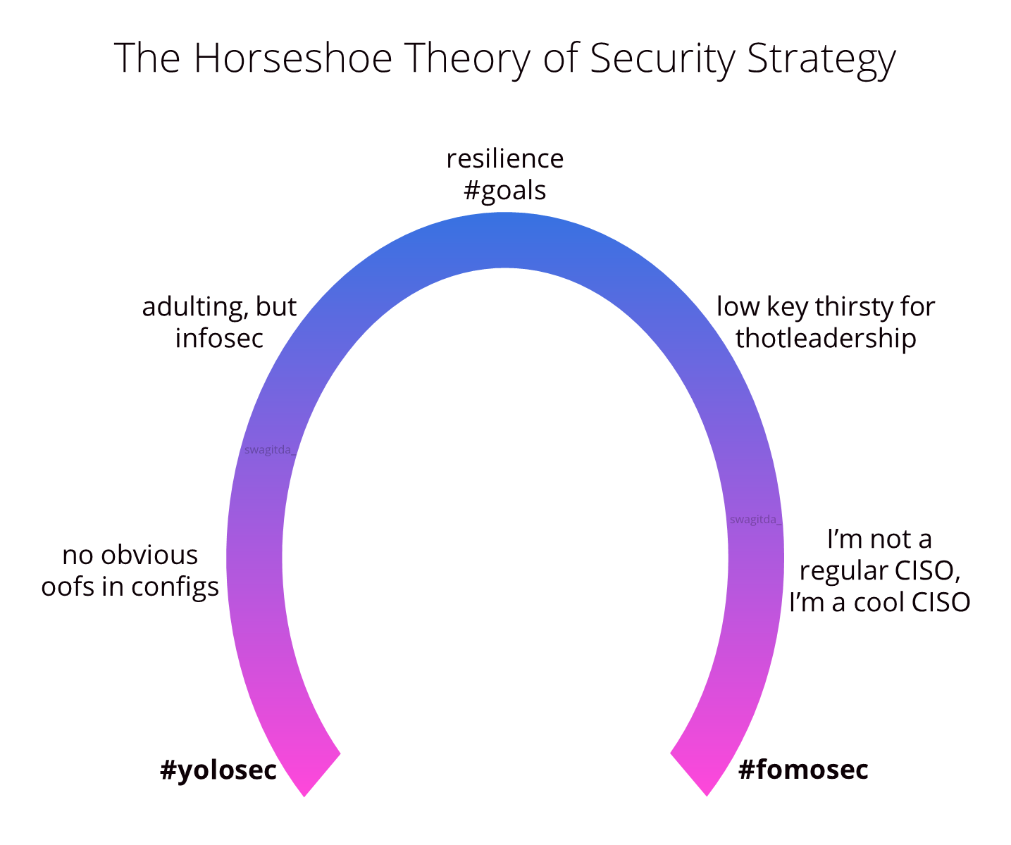
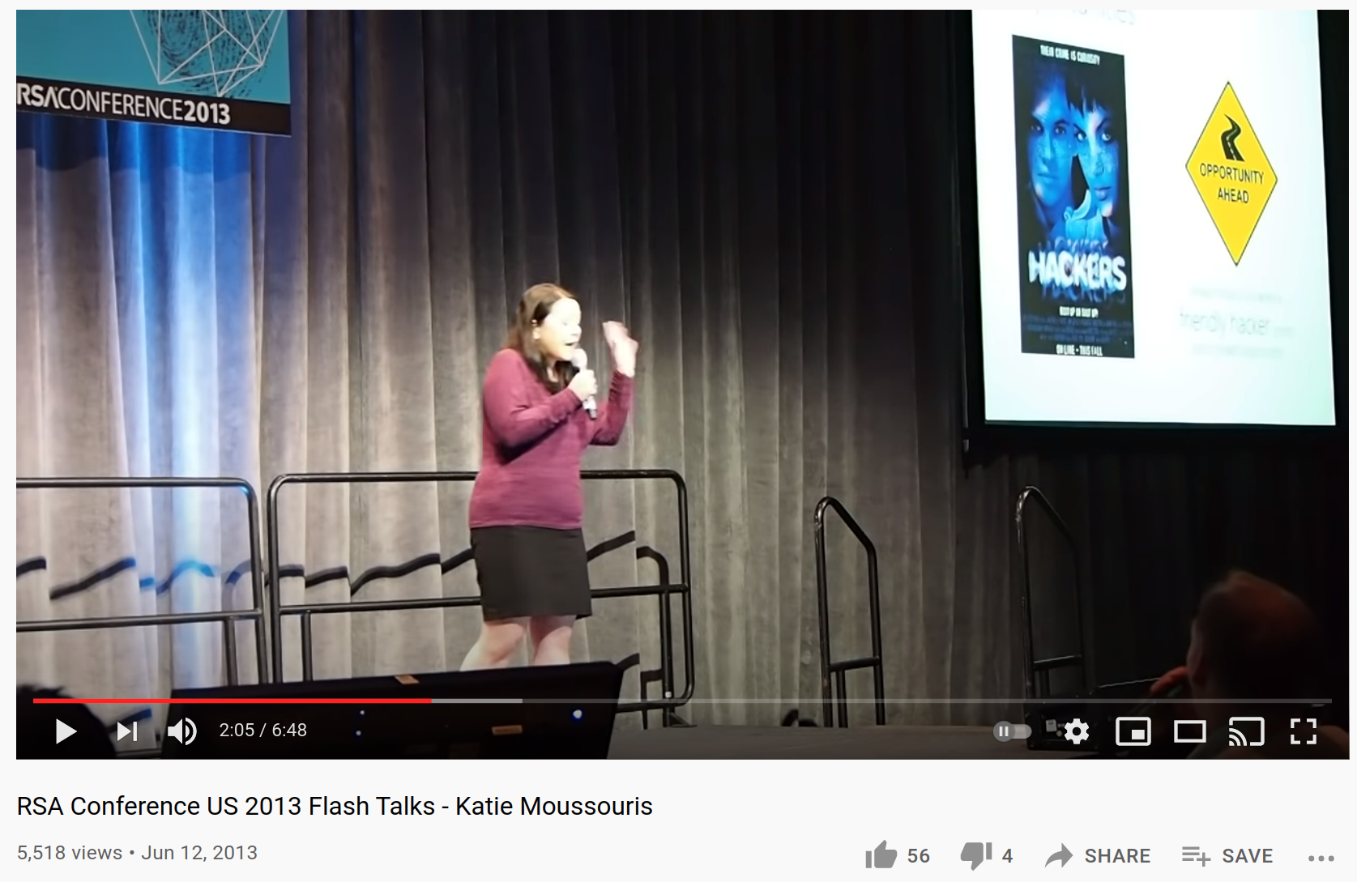
Strategy, maturity, and culture
https://www.youtube.com/watch?v=T6e70upcfl4
https://swagitda.com/blog/posts/on-yolosec-and-fomosec/

Slide 41
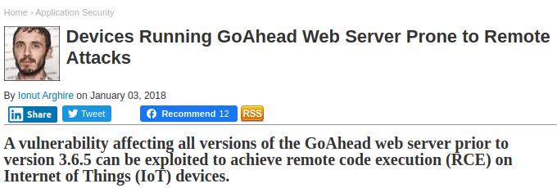
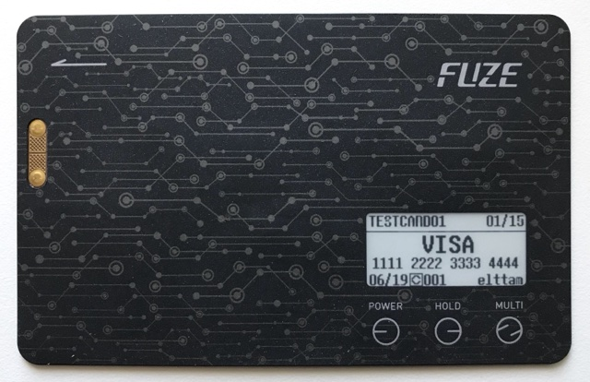
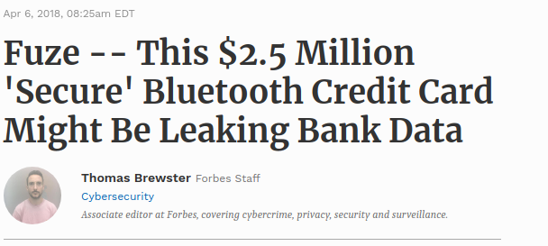
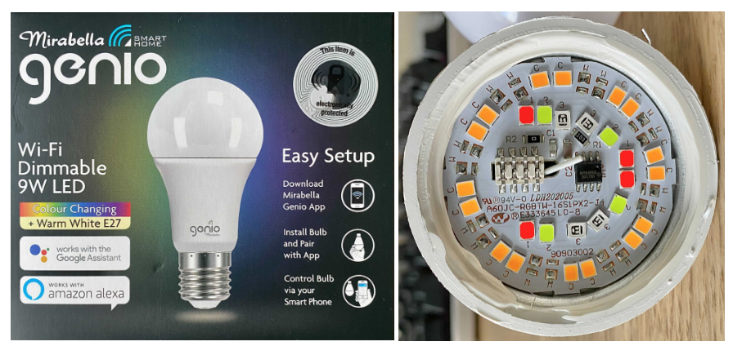
A few of our blog posts
Fuze Multicard Security Review
Remote LD_PRELOAD Exploitation
Tuya IOT and EZ Mode Pairing

Slide 42
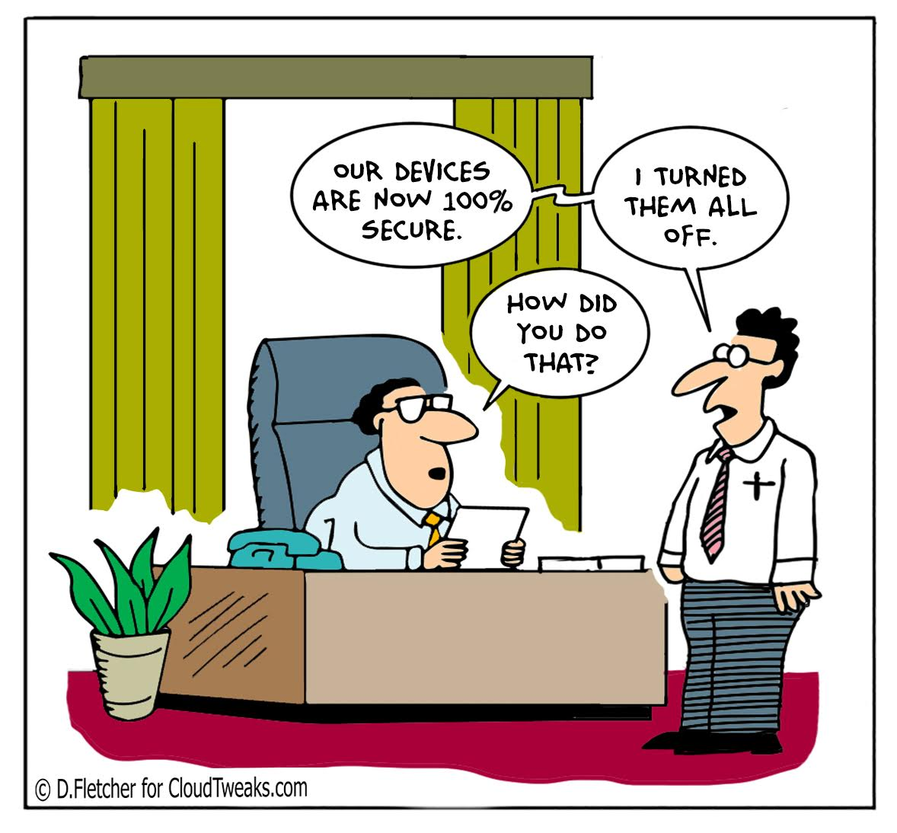
Conclusion
We’re not trying to make perfect bug-free systems, we’re trying to mitigate and reduce risk of likely threats
Secure design considerations and shifting security left is especially important for IoT
Understand the pros and cons of different security assessment methodologies when performing security assurance
Collaborative security assessments helps drive a progressive security culture

Slide 43
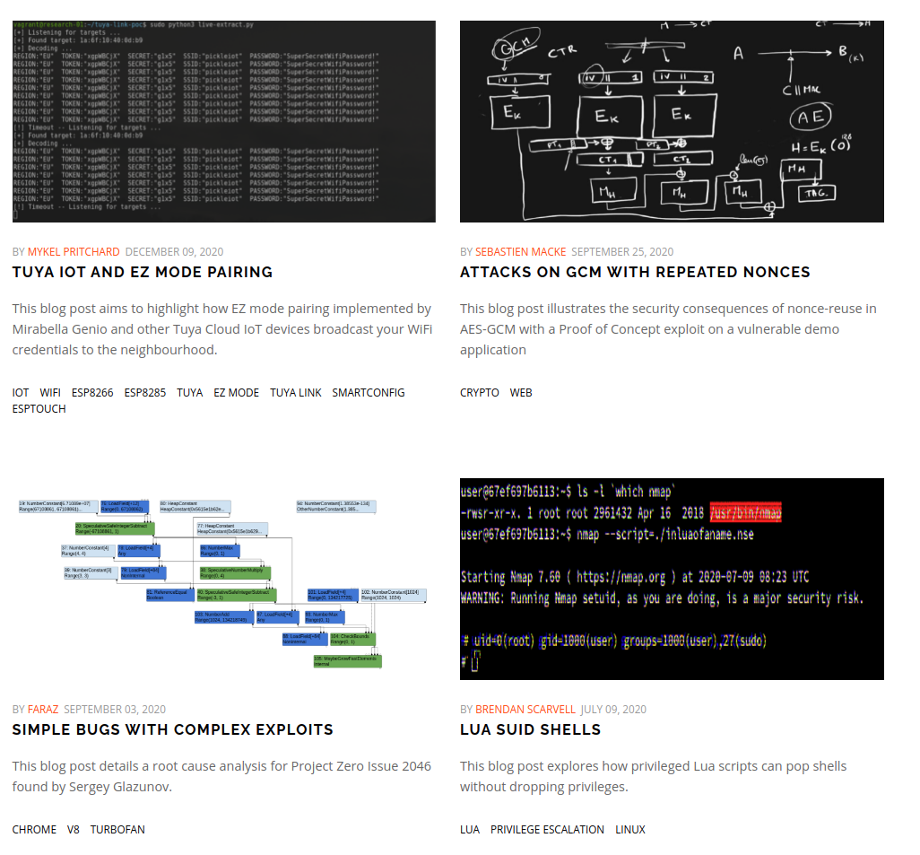

Thank you!
hello@elttam.com www.elttam.com
@elttam
elttam.com/blog

Slide 44


Slide 45
